Slide 1
Understanding Green Star Buildings
For Subcontractors

Slide 2
Objective of this training
Gain deeper knowledge of Green Star Certification and its value to the project
Understand how Green Star applies to you and your work
Understand how to ensure your teams’ work is compliant
Learn the process for confirming your products and materials are compliant with our sustainability team

Slide 3
Sustainability and the Construction Industry
The construction of new buildings is responsible for:
Producing 40% of Greenhouse Gas emissions globally
Consuming 32% of the world’s natural resources
Consuming 40% of the world’s energy
Producing 40% of all landfill
We are in a privileged position to be able to make changes to the way we build that result in huge and valuable impacts to the environment.

Slide 4
Why Certify?
Green Star is a clear guide on how to achieve excellence in sustainable outcomes, providing practical steps to implement.
Project sustainability ratings are also highly valued by the building developers, investors, owners, and tenants.
Building owners
can confidently publish their sustainability claims knowing everything is verified
Owners can communicate sustainability attributes to prospective investors and tenants
Sustainable buildings have been proven to increase physical and mental health, and productivity
Sustainable buildings use over 50% less energy and water, which reduces operating costs

Slide 5
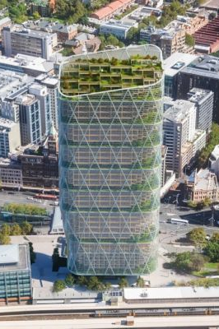
What is Green Star?
Green Star is Australia’s most widely renowned and highly regarded sustainability certification for construction.
Green Star projects:
Reduce carbon emissions and embodied carbon
Enhance the physical and mental health of the tenants
Add value to the local community
Are designed for the future
Contribute to a more sustainable and circular economy

Slide 6
Green Star Buildings
This new edition of Green Star is in 8 categories, with 10 minimum expectations ​
100 points available + 5 Market Transformation points & unlimited Leadership Challenges points
4 Stars = 15 points
5 Stars = 35 points
6 stars = 70 points
e.g. specific to the project
Targeting 6 Star – attempting 85 points

Slide 7
Your responsibilities as a contractor on a Green Star project
Review the Green Star pathway for the project and understand what it signs you up to deliver
Communicate with the Built sustainability team if you have any questions or concerns
Understand material compliance and remember to submit your monthly material tracking to Built to be reviewed and confirmed
(more detail on this later in this training)
Ensure documentation collection systems are set up from the start of the project
Set up back-to-back contracts to ensure compliance by your subbies

Slide 8
Compliant Products and Materials
To ensure we are only using compliant products that meet the Green Star standards, Built must approve all products in the outlined categories.
The process for material tracking requires the following:
Submit a ‘materials forecast’ before purchasing any material, including required evidence
Once your materials have been approved, you can purchase and use the materials
Submit monthly ‘materials tracking’ confirming the materials that have been used each month – this gives you the opportunity to put forward new materials that were not in the forecast. Invoices are also collected as proof of purchase
A final Confirmation Letter is to be signed and all related evidence submitted as part of our Green Star evidence

Slide 9
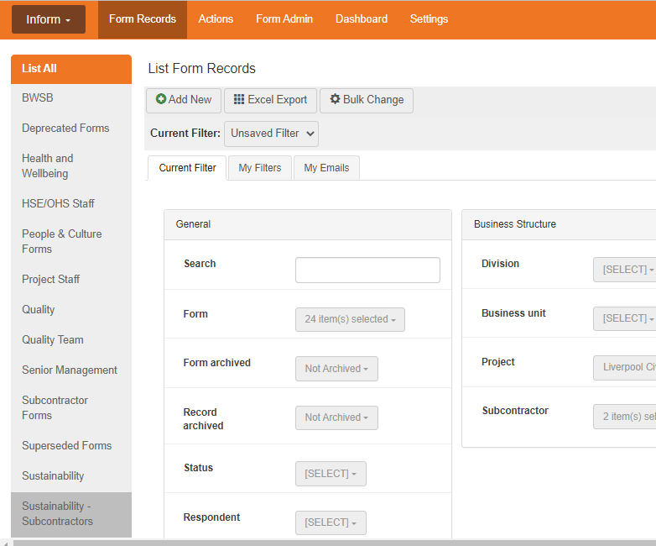
Lucidity
Lucidity link: Lucidity :: Inform (luciditysoftware.com.au)

Slide 10
Toxins: VOCs
What are VOCs? Volatile organic compounds - chemicals that are emitted as gases from certain materials
Noticeable as a strong smell commonly emitted by glues and paints, which can result in negative health effects
We must track carpets, sealants adhesives and paints applied onsite within the building envelope (Excluded: Outside or carpark applications, temp works, pipe cements)

Slide 11
Toxins: Formaldehyde
As with VOC’s, formaldehyde is a strong smelling chemical commonly found in the glue used in engineered wood products
We must track MDF, plywood, particleboard, LVL, HPL, compact laminate, decorative overlaid wood panels (Excluded: timber veneers, formwork, carpark applications)

Slide 12
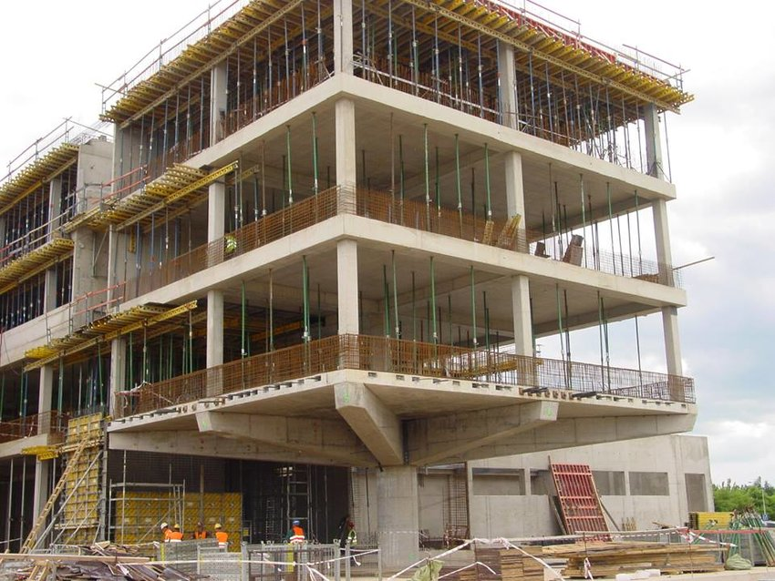
Responsible Structure
Structure trades involved (not limited to):
Structural Steel
Concrete Supply & Place
Reinforcement
Mass Timber
At least 50% of all structural components must have one of the following certifications:
Cradle to Cradle Certified Version 4.0
FSC Certification
GECA
or other recognized certification

Slide 13
Responsible Envelope
The envelope includes the façade, external shading and insulation, suspended slabs and roofing.
At least 30% by cost of all products in the building envelope must have one of the following certifications:
Cradle to Cradle Certified Version 4.0
GECA
GreenRate Level A
or other recognized certification

Slide 14
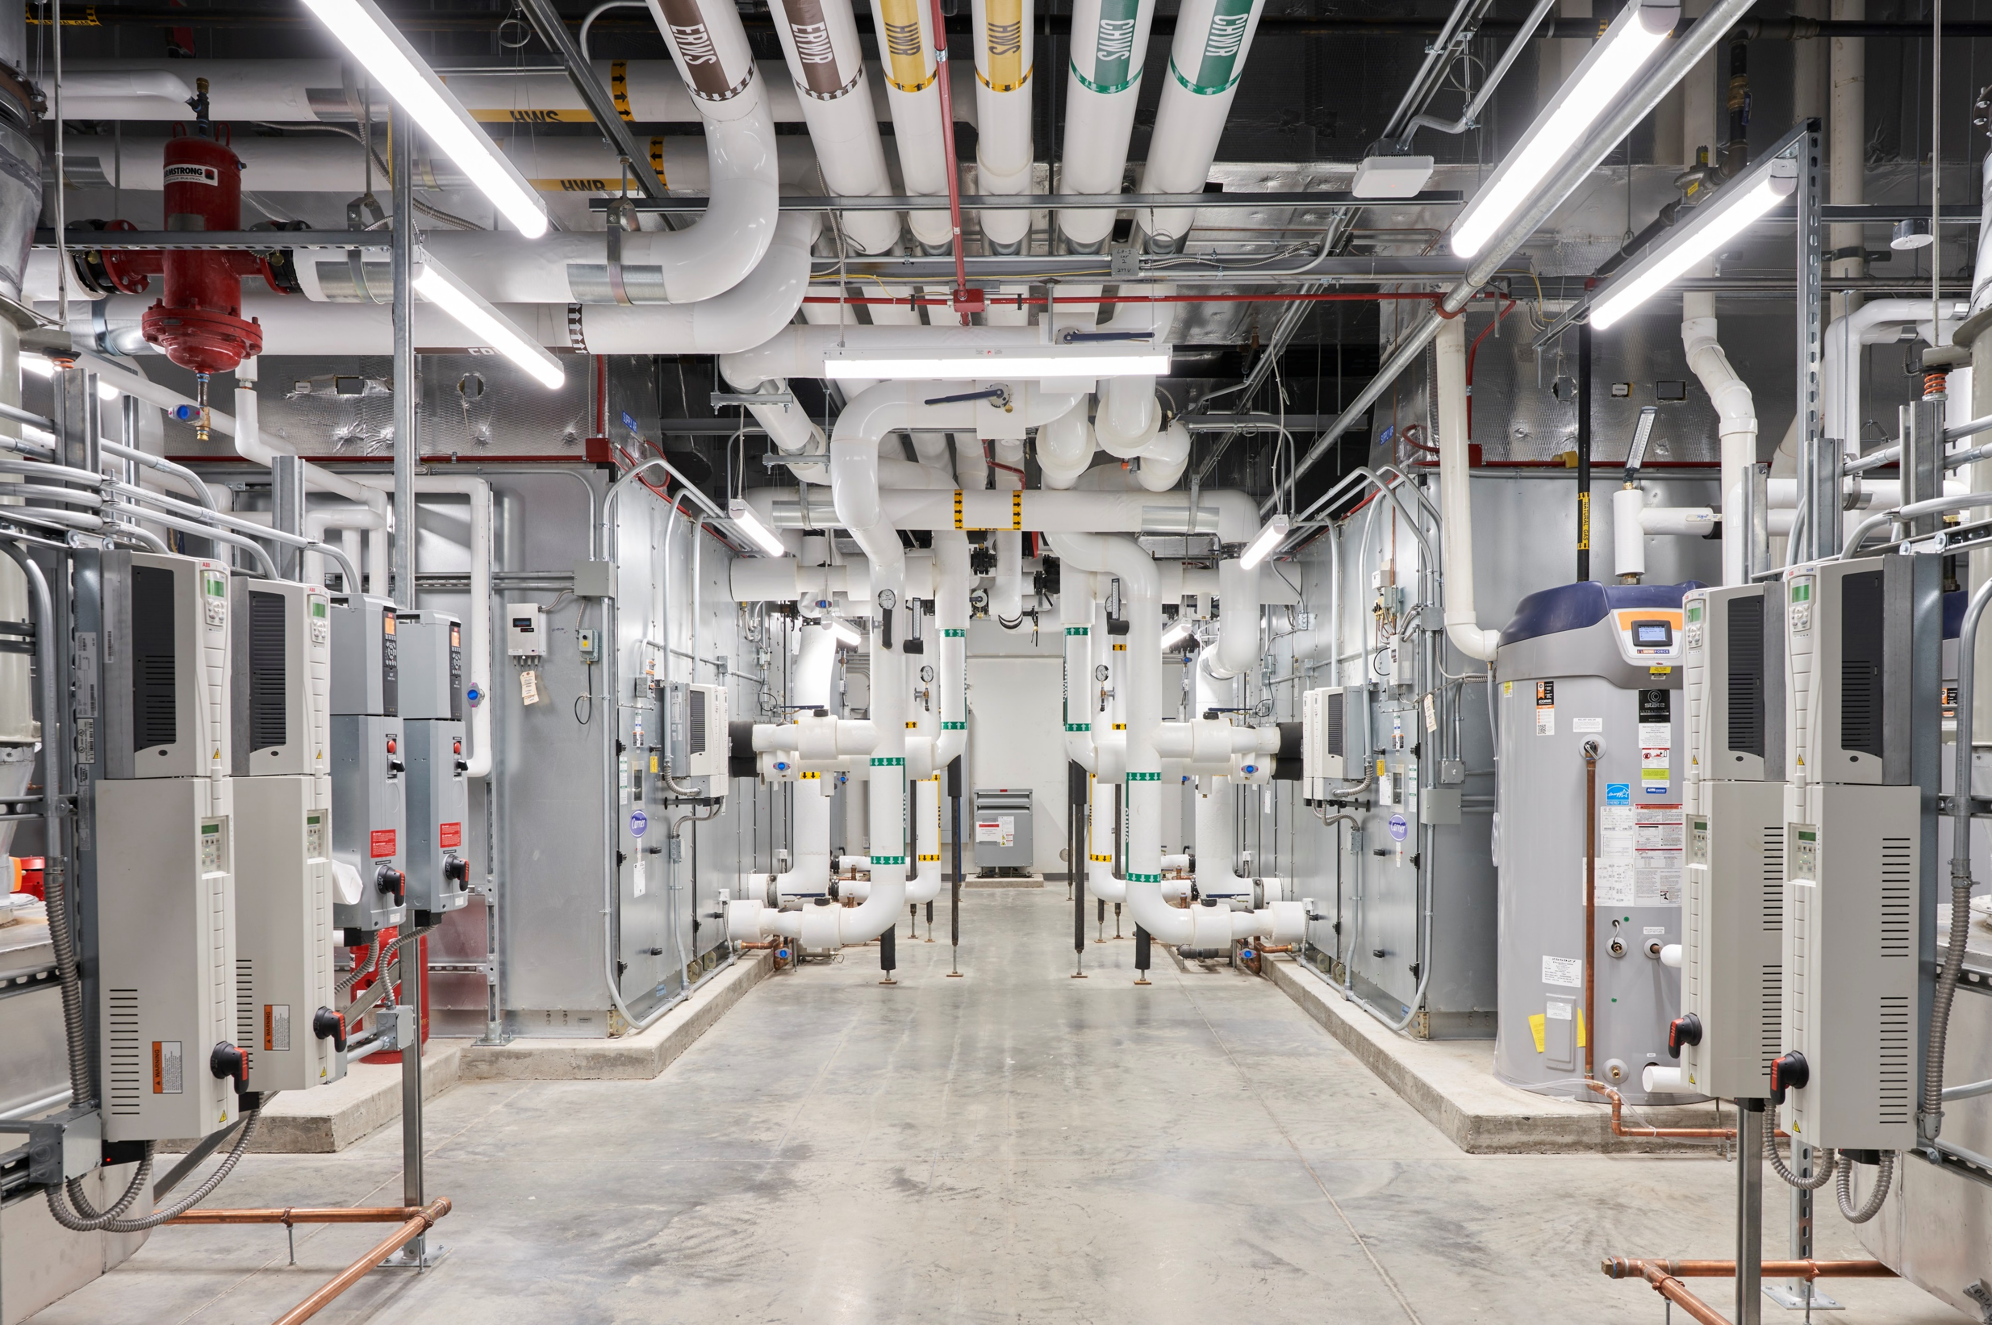
Responsible Systems
Involved trades (not limited to):
Mechanical
Electrical
Fire
Hydraulic
Vertical transport (lifts)
At least 20% of all active building systems must have one of the following certifications:
Climate Active Carbon Neutral for Products & Services
Declare 2.0 Red List Free
GECA
or other recognized certification

Slide 15
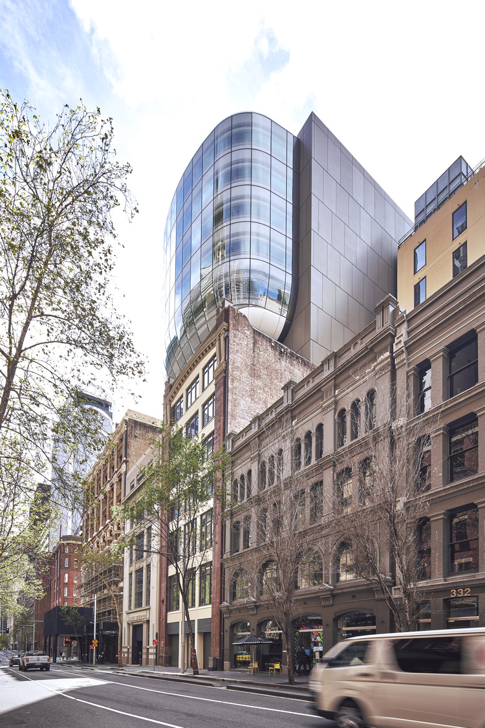
Responsible Finishes
At least 40% of all internal building finishes must have one of the following certifications:
Declare 2.0 Red List Free
Cradle to Cradle Certified Version 4.0
GECA
or other recognized certification
Involved trades (not limited to):
Partitions & Ceilings
Painting
Doors
Joinery
Flooring

Slide 16
Embodied Carbon
Min 10% embodied reduction
Target 20% for credit achievement or 40% for exceptional performance
Opportunities include:
Structural optimisation (Built design VEs)
Structural timber
Low EC concrete mixes (EcoPact, Envisia, etc)
Low EC steel
Low EC aluminium in façade
Finishes optimisation (exposed services, other dematerialisation)
Carbon neutral certified products

Slide 17
Sustainability Contacts
Joe Karten | Head of Sustainability and Social Impact | joekarten@built.com.au | +61 431 744 803
Clare Gallagher | National Sustainability Manager | ClareGallagher@built.com.au | +64 27 427 6840
Filomena Beshara | Sustainability Manager | filomenanigro@built.com.au | +61 478 290 250
Jaslyn Brown | Sustainability Engineer | JaslynBrown@built.com.au | +61 438 714 418
Haneen Jaber | Sustainability and Social Impact Lead, Vic | HaneenJaber@built.com.au | +61 429 496 840
Yasmin Blake | Sustainability Coordinator | yasminblake@built.com.au | +61 499 629 094
Pippa Harrison | National Social Impact Manager | pippaharrison@built.com.au | +61 427 118 691

